Slide 1
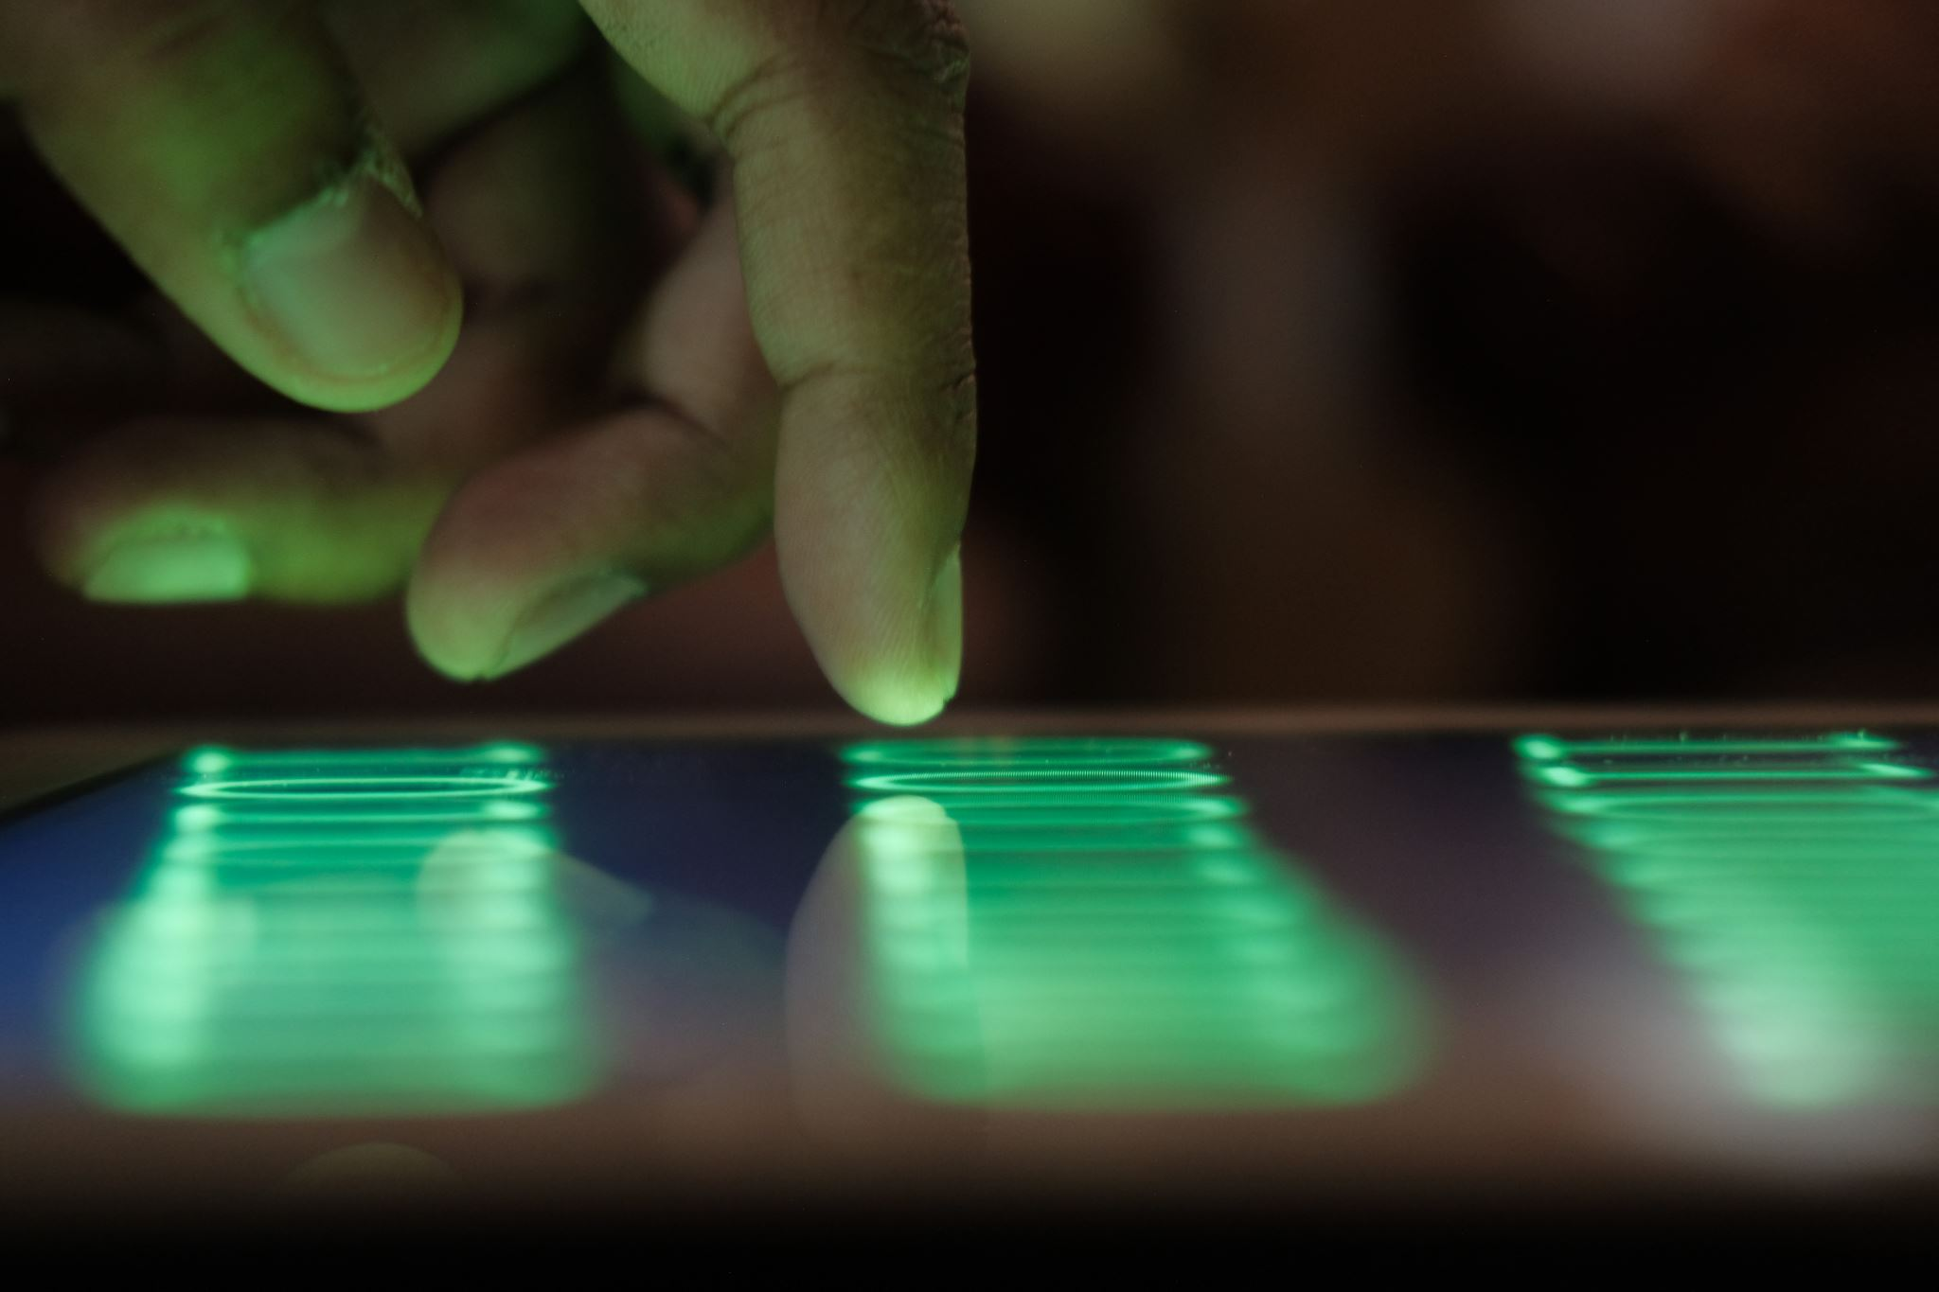

Predicting App Usage
Lincoln Brown
Project 2 Milestone 3
DSC680-T301
Professor Iranitalab

Slide 2

Background
The Problem:
Predicting app usage time for users is critical for businesses, app developers, and marketers who aim to increase app usage time and user retention by optimizing the user experience for different target demographics (Admin & Admin, 2025).
The Opportunity:
This project aims to provide actionable insights by identifying key factors associated with app usage time.
Notes:
A little bit of background for our problem: Mobile app usage time is a crucial factor for businesses, app developers, and marketers. Understanding how long users engage with apps helps optimize user experience, improve retention strategies, and drive revenue. App developers need insights into user behavior to provide a better user experience that fosters a personalized experience, which can help lead to longer app usage time and better user retention.
This project aims to provide actionable insights by identifying key factors associated with app usage time.

Slide 3

Dataset
The dataset used in this project is Mobile Device Usage and User Behavior Dataset found on Kaggle, uploaded by user Vala Khorasani. The dataset contains 700 samples of user data including metrics such as app usage time, screen-on time, battery drain, number of apps installed, data usage, and user specific features such as age and gender.
Notes:
The dataset used in this project was uploaded to Kaggle by user Vala Khorasani. The dataset contains 700 samples of user data including metrics such as app usage time, screen-on time, battery drain, number of apps installed, data usage per day, and user specific features such as age and gender.

Slide 4

Methods
This project built and evaluated the following models for predicting app usage time:
Linear Regression Model
Random Forest Model
XGBoost Model
Notes:
This project built and evaluated three different models to predict app usage time. They were:
Linear regression, random forest, and extreme gradient boosting, also known as XGBoost.

Slide 5

Performance Metrics
The following metrics were used to evaluate performance:
Root Mean Squared Error (RMSE) - is a measurement of the average difference between the model’s predicted values and its actual values (Frost, 2023).
Mean Absolute Error (MAE) - is a measurement of the absolute discrepancies between a dataset’s actual values and predicted values (GeeksforGeeks, 2024).
R2 Score – is the percentage of the response variable variation that is explained by a linear model (Frost, 2017).

Slide 6
Model Results
Model | MAE | RMSE | R² Score
Linear Regression | 34.745836 | 44.74348 | 93.96%
Random Forest | 28.735362 | 35.751961 | 96.14%
XGBoost | 31.244812 | 38.389111 | 95.56%
Notes:
Here, we can see a table that displays the results of each model's performance. When looking at MAE and RMSE, lower scores are better. In the case of the R2 score, higher percentages are better.
From these results, we can see that the Random Forest model achieved the best scores in each of the three metrics.
With an MAE of 28.74, an RMSE of 35.75, and an R2 score of 96.14%

Slide 7
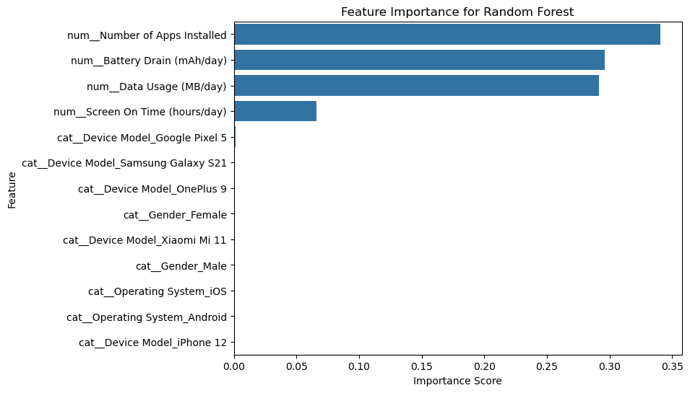
Random Forest Important Features
Notes:
Here we can see the most important features for prediction based on the Random Forest Model, which had the best performance metrics.
From this we can see that the most important features for prediction were the number of apps installed, the daily battery drain, daily data usage, and daily screen on time.

Slide 8

Challenges
Limited Features
Limited Dataset
Notes:
The dataset used in this project was limited in the amount of features it had. It would have been beneficial to have more information about the specific apps being used, the duration of their use, and the number of notifications that each user received. However, this was out of scope for the dataset and efforts to find more comprehensive datasets were unsuccessful.

Slide 9
Implementation Plan
Future implementations of this project are limited due to its intended purpose as an educational exercise.
The models used in this project are applicable to other datasets and it would be beneficial to investigate more comprehensive datasets in the future for more specific insight into predicting user behavior.

Slide 10
Ethical Considerations
The ethical implications of this project were minimal. The dataset was not sensitive and did not contain any personally identifiable information.
Additionally, the model seemed to adequately capture the diversity of age groups and genders represented in the dataset.

Slide 11
Conclusion
Random Forest performed best, achieving the lowest MAE & RMSE and highest R².
Key predictors of app usage time:
Number of apps installed
Daily battery drain
Daily data usage
Future analysis could benefit from more granular data, such as notifications received, app types, and time between app usage.
Notes:
In conclusion, the Random Forest model performed the best, having achieved the lowest MAE and RMSE scores, as well as the highest R2 Score.
The key predictors of app usage time with this model were the number of apps installed, the daily battery drain, and the daily data usage features.
Future analysis related to this project could benefit from a more feature-rich dataset and/or more granular metrics, such as notifications received, app types, and time between app usage.

Slide 12
Questions
1. Why did you choose the Mobile Device Usage and User Behavior dataset?
2. How did you handle any incomplete or missing data?
3. What made the Random Forest model outperform the Linear Regression and XGBoost models?
4. Were there any features that surprised you by being less significant predictors of app usage?
5. Did you find any unexpected trends or patterns in the data?
6. Do you think that the data might have potential bias?
7. What specific industries or organizations could benefit from the models developed in this project?
8. If you had a more comprehensive dataset, which new research questions would you want to explore?
9. Could your predictive model be integrated into mobile app development to optimize user engagement?
10. What was the average app usage time?
Notes:
Now we will address ten questions.
The first one, why did you choose the mobile device usage and user behavior dataset. Initially, I was looking at another dataset, but after I realized it did not have specific user information, I opted for this dataset instead. However, I would have liked to see more features included with this dataset.
2. How did you handle any incomplete or missing data. A total of 11 records were removed because they were missing the Age of the user. Alternatively, I could have imputed the mean for the age in this fields, but I chose to just remove them to keep the data as realistic as possible.
3. What made the Random Forest model outperform the Linear Regression and XGBoost Models? The Random Forest model performed better than the Linear Regression because the ensemble of decision trees allows it to identify nonlinear relationships better. As for the XGBoost model, the random forest model probably performed better because I did not go through extensive hyperparameter tuning which can help the XGBoost model perform better. The Random Forest model was able to generalize better without the need for fine tuning.
4. Were there any features that surprised you by being less significant predictors of app usage? Not after I performed the exploratory data analysis and discovered that there were not any significant differences in age groups. Initially, I suspected that there were would be considerable differences in app usage time between different age groups, but that was not the case with this dataset.
5. Did you find any unexpected trends or patterns in the data? Not especially, as I said previously, I expected there to be a larger differential for app usage between age groups. However, this was not the case.
6. Do you think that the data might have potential bias? No, I do not think that the dataset was biased.
7. What specific industries or organizations could benefit from the models developed in this project? This project was developed as an educational exercise, but these types of models could be put to use by any business using an app that wants to understand its customer base better.
8. If you had a more comprehensive dataset, which new research questions would you want to explore? I would want to see the types of apps people use the most, the time of day where most of the app usage occurs, and the impact that notifications have on app usage time.
9. Could your predictive model be integrated into mobile app development to optimize user engagement? I think that a model similar to mine that was trained on the appropriate data could be used in this scenario, but not this model specifically.
10. What was the average app usage time? The average app usage time for the entire dataset was 271 minutes or about 4 and a half hours a day.

Slide 13
References:
Admin, & Admin. (2025, January 20). Predictive Analytics in Mobile Apps: Key 2025 trends. Nordstone - Mobile App Development. https://nordstone.co.uk/blog/the-role-of-predictive-analytics-in-mobile-apps-trends-for-2025
Frost, J. (2023, May 28). Root Mean square Error (RMSE). Statistics by Jim. https://statisticsbyjim.com/regression/root-mean-square-error-rmse/
Frost, J. (2017, May 5). R-Squared - Statistics by Jim. Statistics by Jim. https://statisticsbyjim.com/glossary/r-squared/
GeeksforGeeks. (2024, July 29). Regression metrics. GeeksforGeeks. https://www.geeksforgeeks.org/regression-metrics/

